Slide 1

Feedback Web APP Wire Frame
Frontend Team

Slide 2
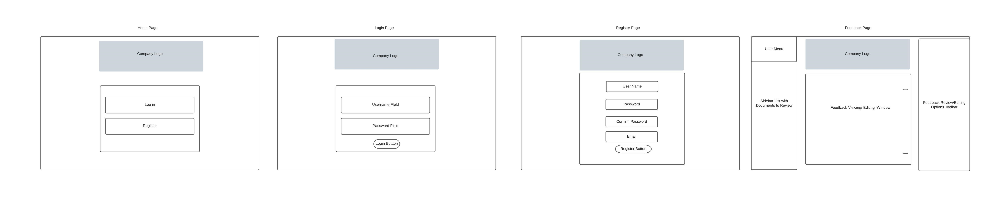
Overview

Slide 3
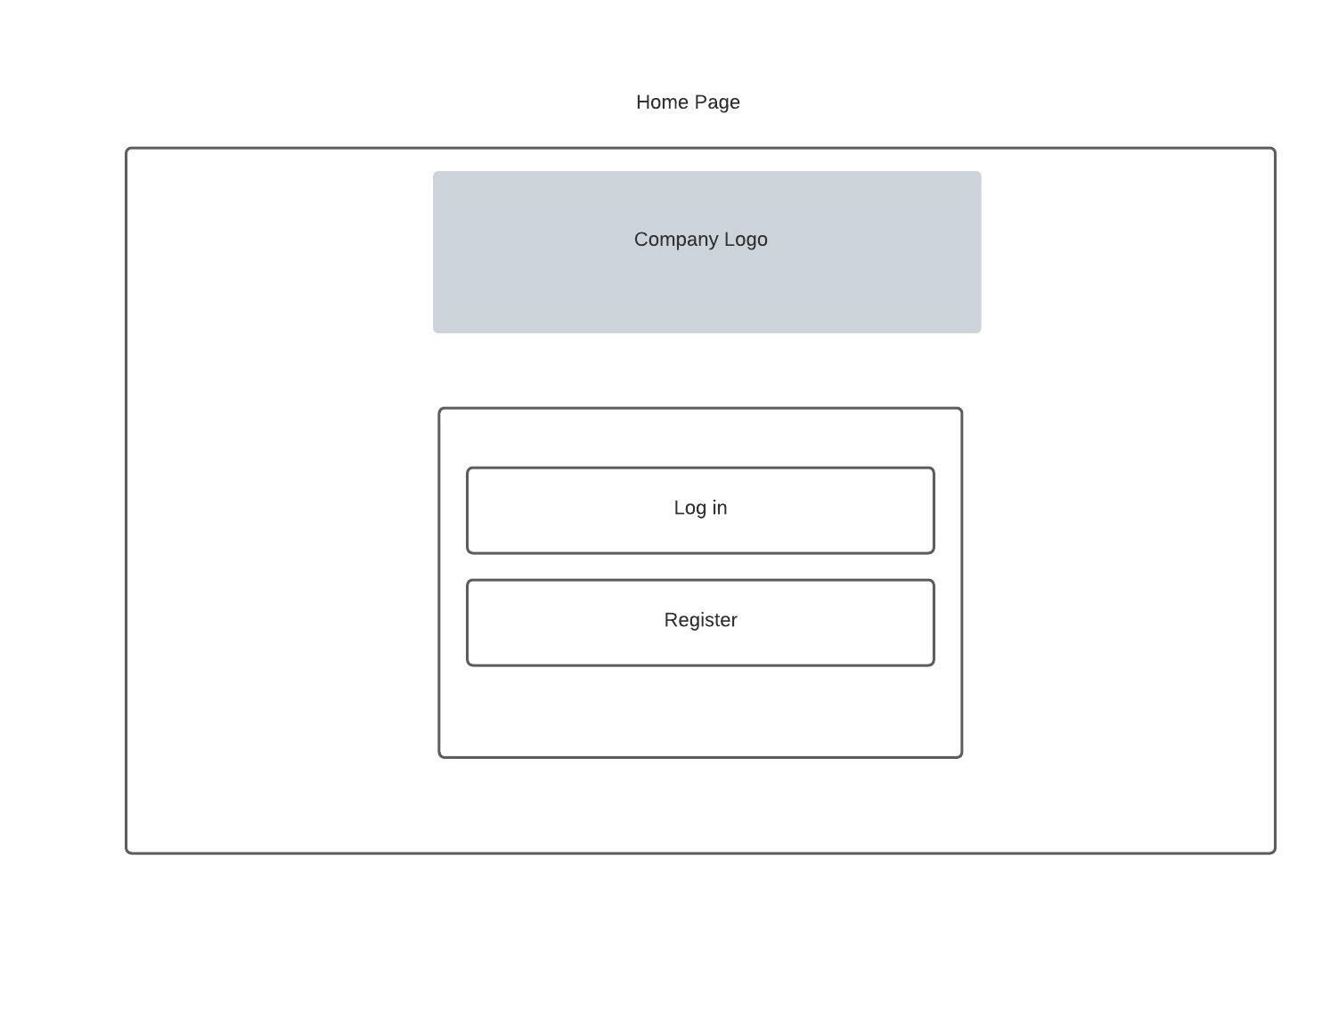
Home Screen
Company Logo for App Identification
Buttons to enter Student or Instructor Interfaces
Register for a feedback account

Slide 4
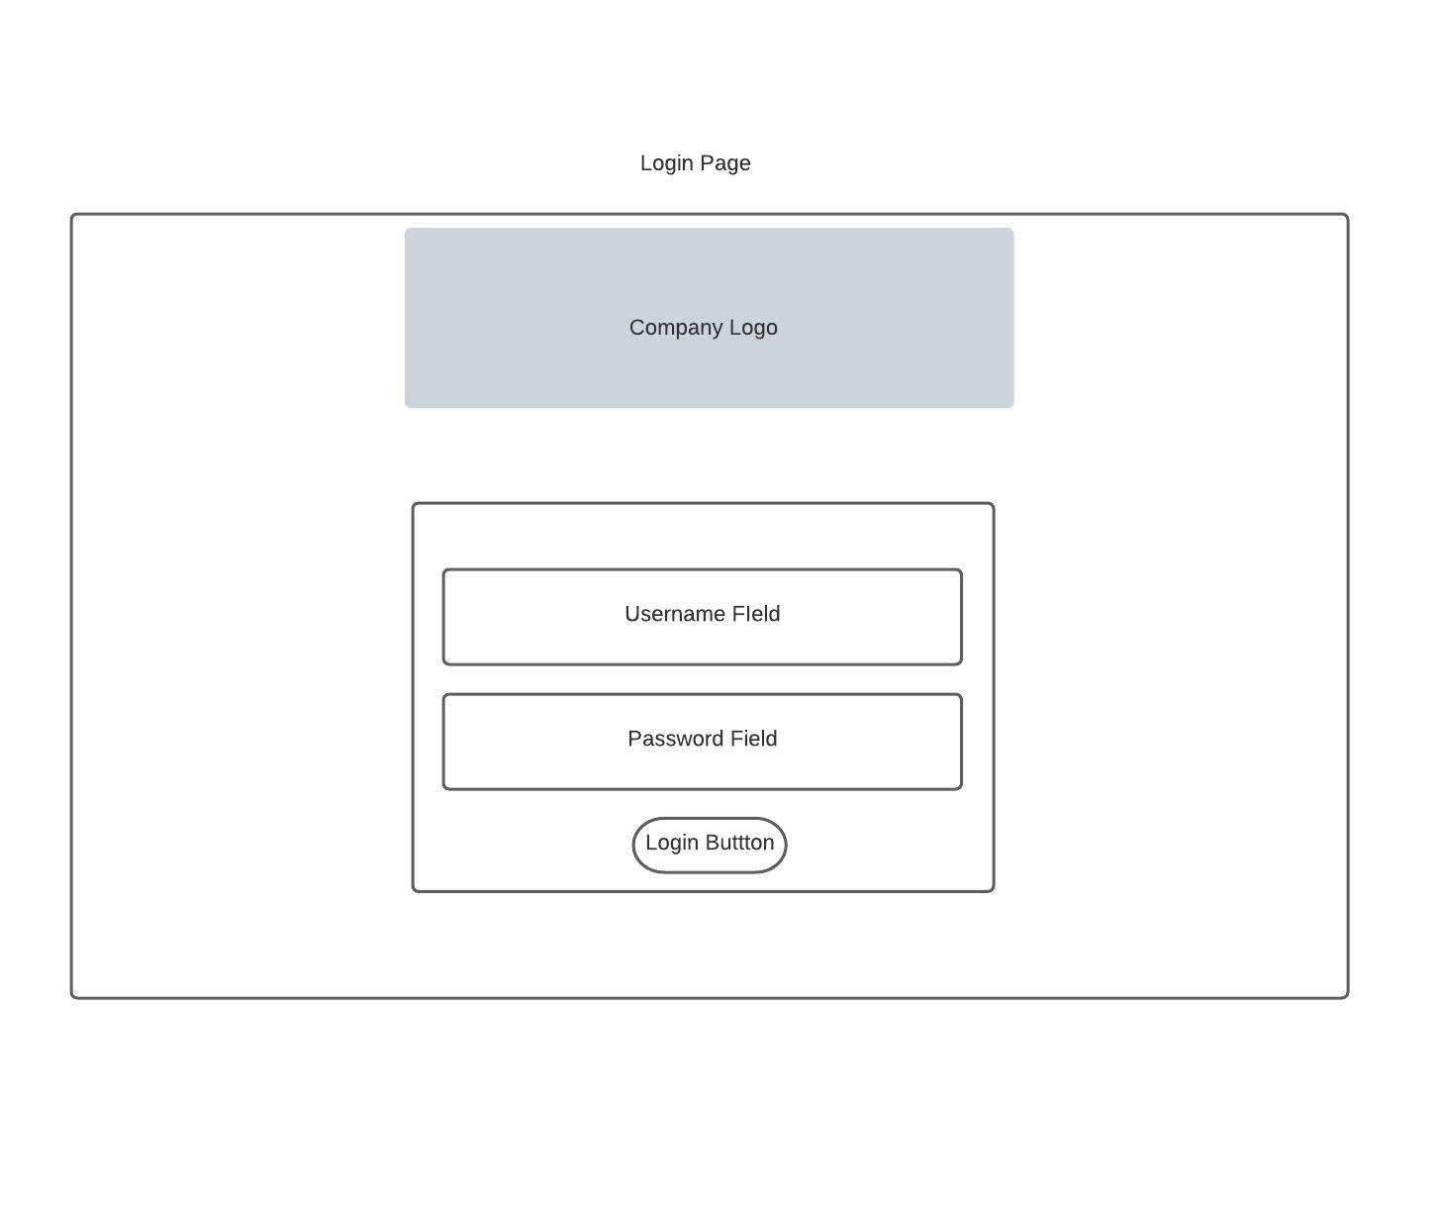
Login Page
User Login Credential Fields
Button to go to Feedback Document Screen

Slide 5
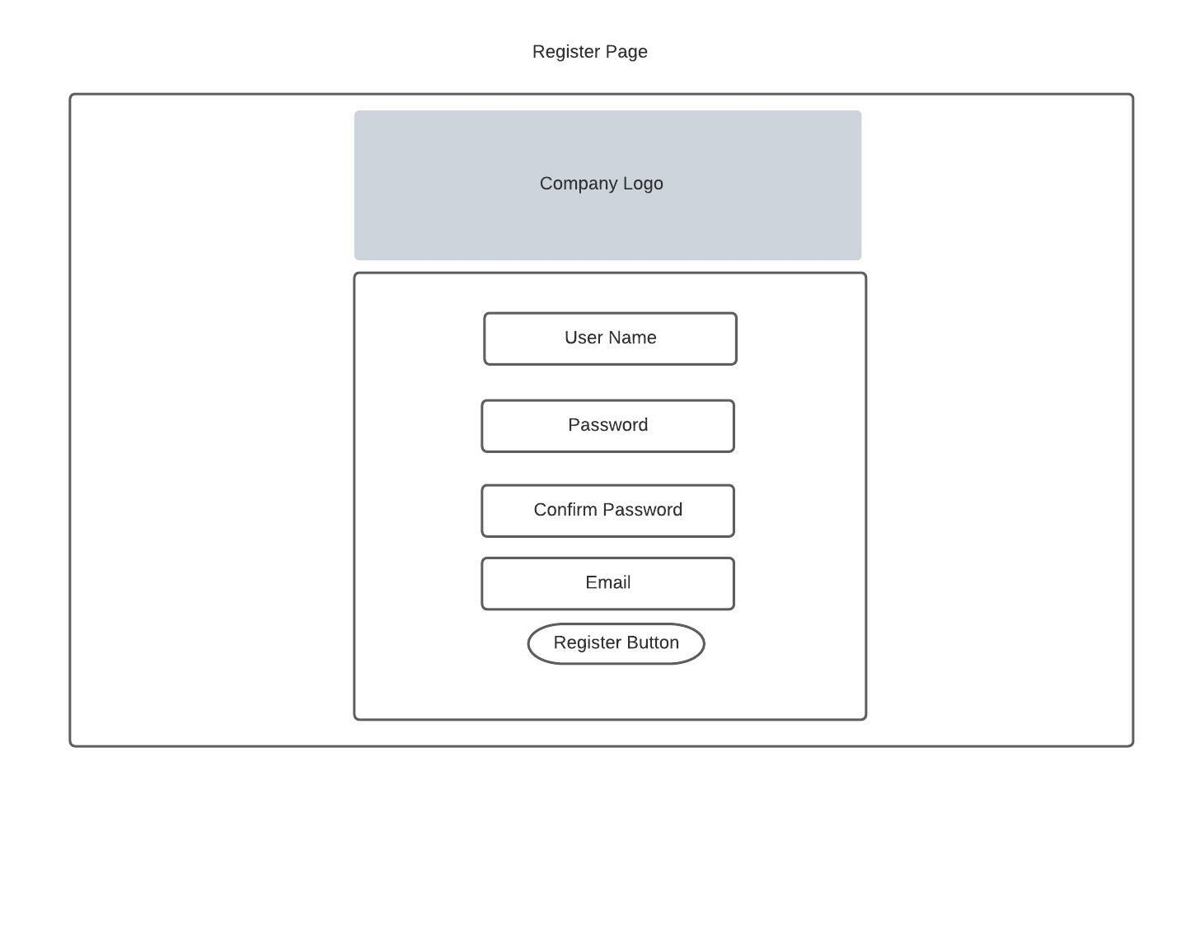
Registration Screen
Fields to collect user information for authentication
Button to submit info to user database

Slide 6
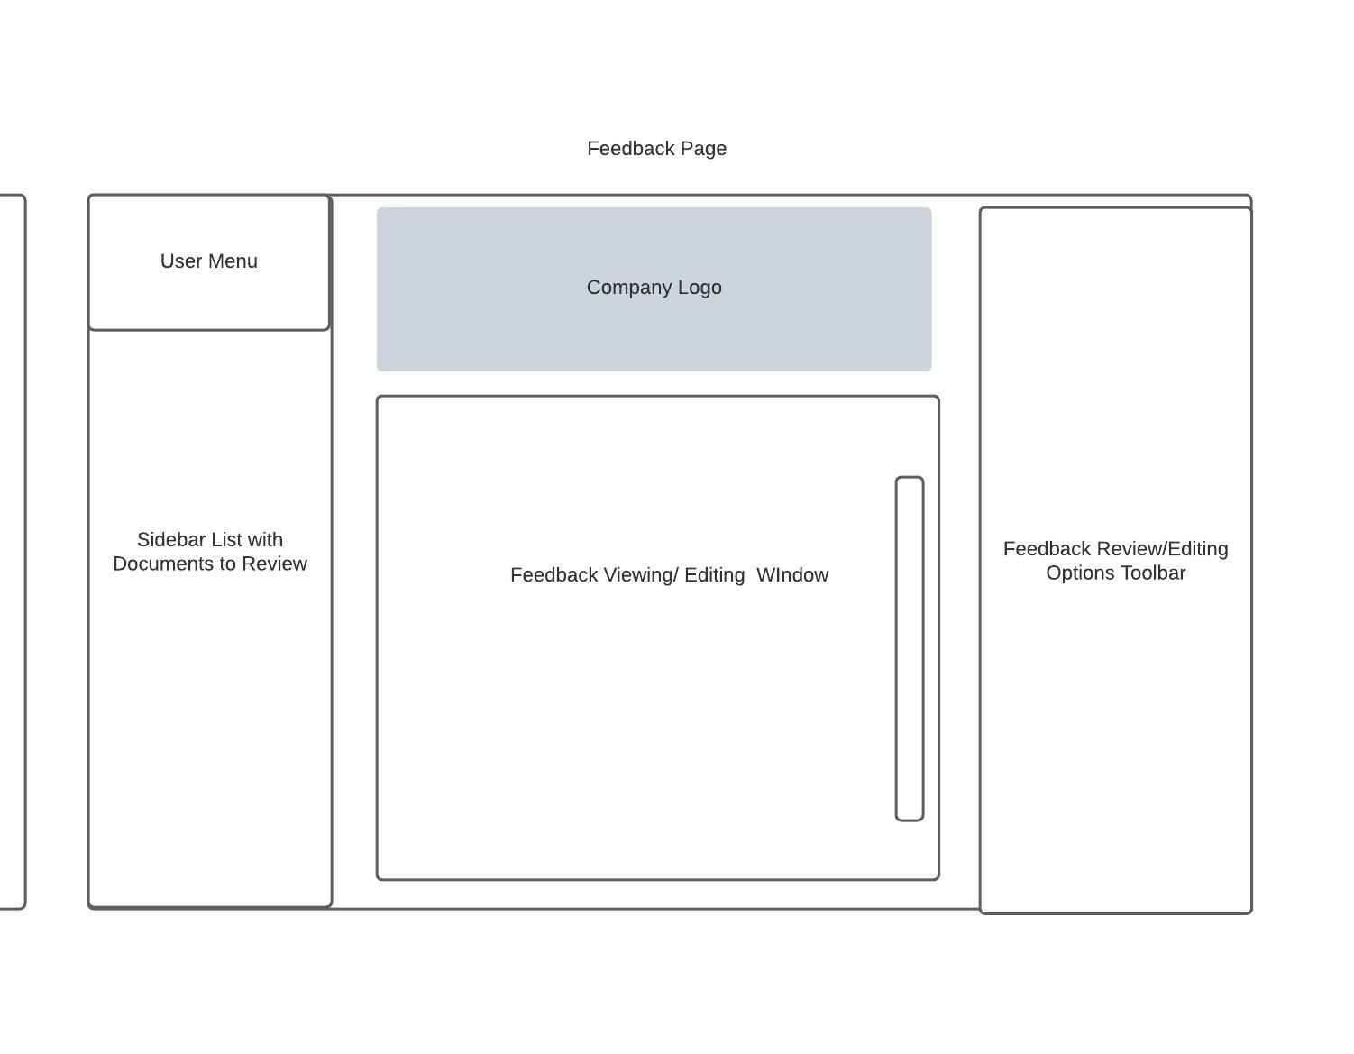
Feedback Review and Edit Screen
User menu for user related tasks (logout to home button)
Toolbar with buttons for editing and review options
Viewing window to read document and see feedback
List of all feedback documents related to user that can be viewed
Scroll bar to see full document

